Slide 1
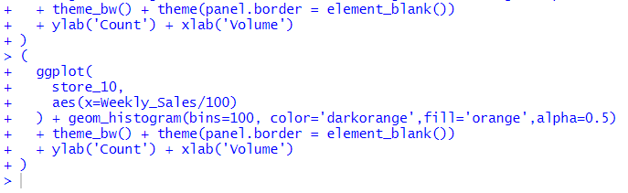

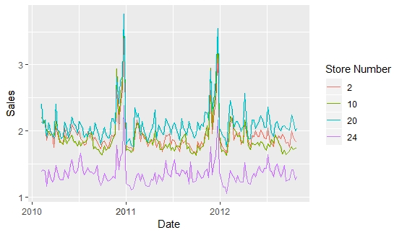
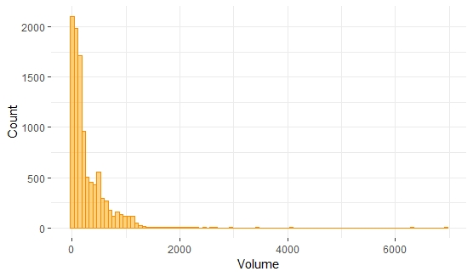


Slide 2

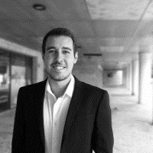

8 years of experience in data analytics related roles.
Based in Lisbon, Portugal.
Started in ETL/Databases, moved to Data Science and now I work in DareData Engineering, a portuguese startup.
Worked mostly in retail, banking and as a consultant.
Motivations for this course:
To help non-coders embrancing a coding language
Help business analysts to power up their data analysis toolkit
Help entry level data scientists to understand the power of R as a statistical tool.
LinkedIn: https://www.linkedin.com/in/ivobernardo/
DareData website: https://daredata.engineering/home

Slide 3






Slide 4







Slide 5

